Slide 1

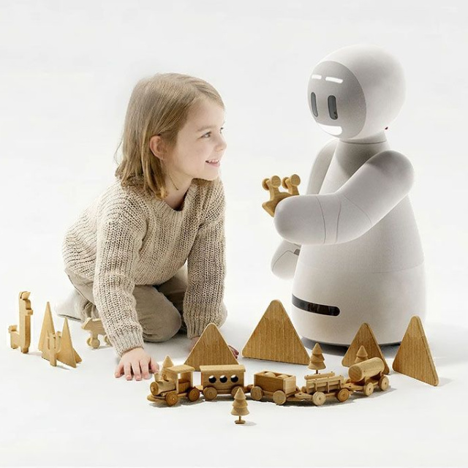
What Is A Complaint?
Learning how to speak up when things go wrong!

Slide 2
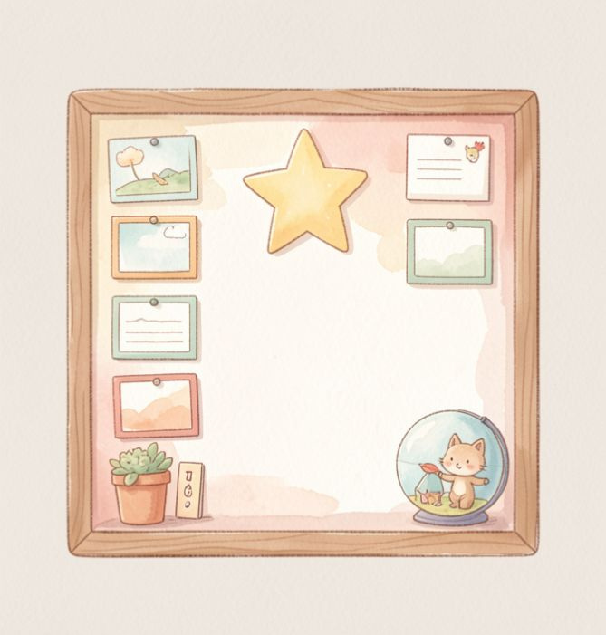
Our Learning Journey
Today we will:
Understand what a complaint is.
Learn how to be polite and clear.
Find the three parts of a complaint.

Slide 3
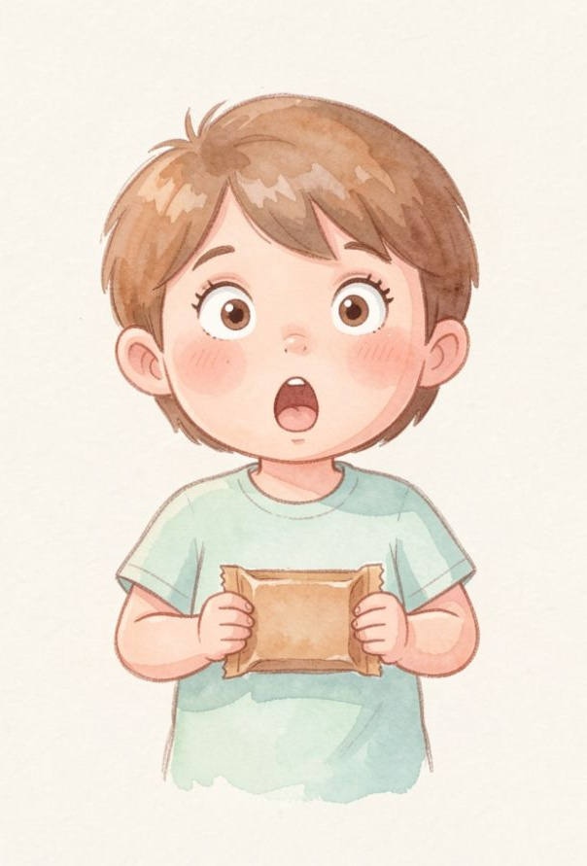
Has this ever happened?
Imagine you buy a yummy chocolate bar, but when you open it, it is empty!
How would you feel? A complaint is when we tell someone that something is not right so they can fix it.
🔑
Key point
We use a polite voice so people want to help us.

Slide 4

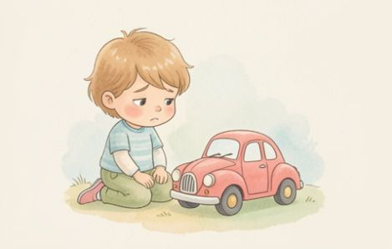

The Three Magic Parts
To write a great complaint, we need these three things:
The Problem
What is wrong?
The Reason
Why is it a problem?
The Outcome
What should happen now?

Slide 5

The Soggy Sandwich
Listen to the audio and answer the questions
Ben talks about his lunch
▶ Play audio
1
What was the problem with the food?
2
Why did the problem happen?
3
What was the desired outcome?
4
How did Ben speak to the staff?
Answers on the next slide...

Slide 6
The Soggy Sandwich
✅​
Check your answers below
Ben talks about his lunch
▶ Play audio
1
The sandwich was soggy.
2
The tomato leaked through the bread.
3
Ben wanted a fresh sandwich.
4
He was polite and said thank you.

Slide 7
Complaint Words
1.
Outcome
a)
Why it is a problem.
2.
Polite
b)
Being kind and respectful.
3.
Problem
c)
What we want to happen next.
4.
Reason
d)
Something that is wrong.

Slide 8
Complaint Words
✅​
1.
Outcome
c)
What we want to happen next.
2.
Polite
b)
Being kind and respectful.
3.
Problem
d)
Something that is wrong.
4.
Reason
a)
Why it is a problem.

