Slide 1


Writing a Clear Complaint Letter
Being polite and firm to get things fixed!

Slide 2
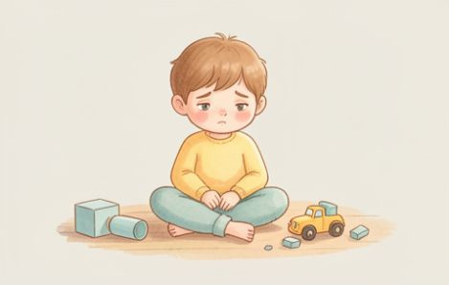


What's in a Letter?
Remember our three magic ingredients for a perfect complaint!
The Reason - Why is it a problem? (e.g., I cannot play).
The Problem - What is wrong? (e.g., The toy is broken).
The Outcome - What do you want? (e.g., A new toy).

Slide 3

Quick Check!
Question 1:
What do we call the part that explains what is wrong?
Question 2:
What is an 'Outcome' in a complaint letter?
Question 3:
Is 'I want a new toy' a problem or an outcome?
Answers on the next slide...

Slide 4
Quick Check!
✅​
Answer 1:
The Problem
Answer 2:
What you want the shop to do to help.
Answer 3:
An outcome

Slide 5
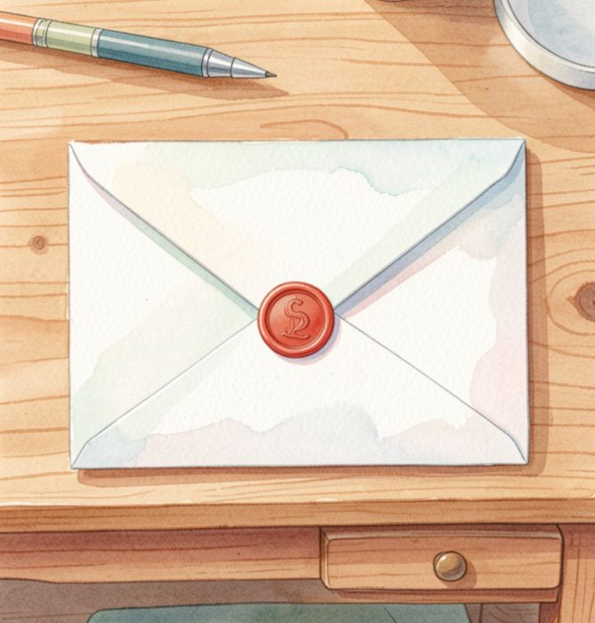
Using Polite Power
When complaining, use polite language. It helps people listen!
🔍
Example
Instead of 'Your food was yucky!', say 'I did not like this meal.'
Try this:
Change 'Fix it now!' to 'Could you please help?'

Slide 6

A Phone Complaint
Listen to the audio and answer the questions
Calling the Toy Shop
▶ Play audio
1
What item was Mrs. Smith calling about?
2
What was the problem with the item?
3
What was the desired outcome?
4
Was Mrs. Smith polite or rude?
Answers on the next slide...

Slide 7
A Phone Complaint
✅​
Check your answers below
Calling the Toy Shop
▶ Play audio
1
A puzzle.
2
Two pieces were missing.
3
Mrs. Smith wanted a new puzzle.
4
She was polite (she said please and thank you).

Slide 8


Your Turn: Write a Letter!
Dear Shop Manager, I bought a superhero cape, but the gold star fell off immediately. I cannot wear this to my party as intended. Please provide a full refund for this defective item. Thank you for your assistance. Sincerely, A Disappointed Customer.

