Slide 1

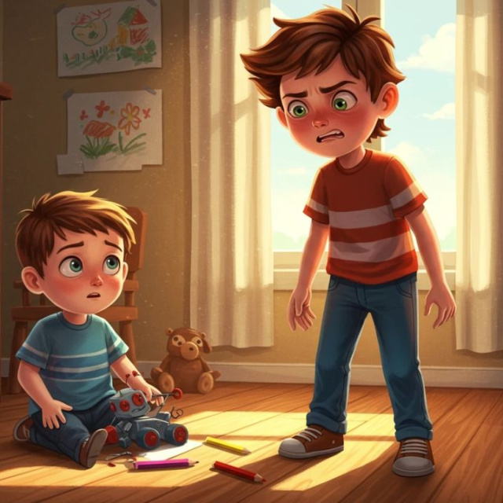
The Broken Toy Mystery
Finding out what went wrong!

Slide 2

Today's Goals
What we will do:
Read a story about a problem.
Find facts (what happened).
Think like a detective (why it happened).

Slide 3

The Rocket Ship Disaster
Read the story:
Leo opened his Mega-Rocket. He pushed the red button, but the wings stayed shut. He saw a crack in the plastic. His new toy was broken!

Slide 4

A Phone Call to the Shop
Listen to the audio and answer the questions
Leo's Mum calls the toy shop
▶ Play audio
1
What toy was Mum talking about?
2
What part of the toy was broken?
3
How did the toy break?
4
What will the shop give to Leo?
Answers on the next slide...

Slide 5
A Phone Call to the Shop
✅​
Check your answers below
Leo's Mum calls the toy shop
▶ Play audio
1
A toy rocket.
2
The wing.
3
It was already broken in the box.
4
A new rocket.

Slide 6

Retrieval vs Inference
What happened?
This is retrieval. We can see it in the story! The rocket has a crack.
Why did it happen?
This is inference. We use clues. The rocket might have been dropped at the factory.

Slide 7
Solve the Mystery Words
1.
Complaint
a)
What you want to happen next.
2.
Problem
b)
Telling someone you are unhappy.
3.
Outcome
c)
The thing that is wrong.
4.
Reason
d)
Why the thing went wrong.

Slide 8
Solve the Mystery Words
✅​
1.
Complaint
b)
Telling someone you are unhappy.
2.
Problem
c)
The thing that is wrong.
3.
Outcome
a)
What you want to happen next.
4.
Reason
d)
Why the thing went wrong.

