Slide 1
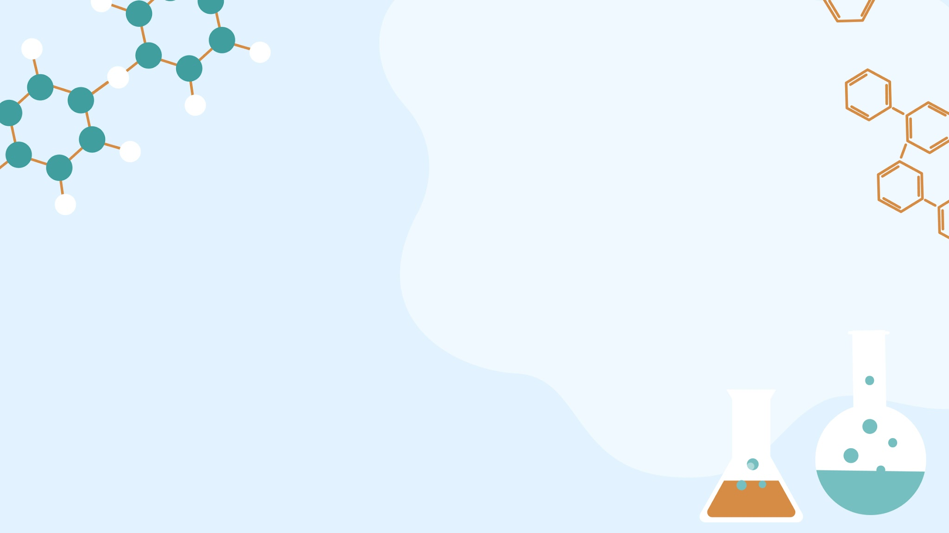
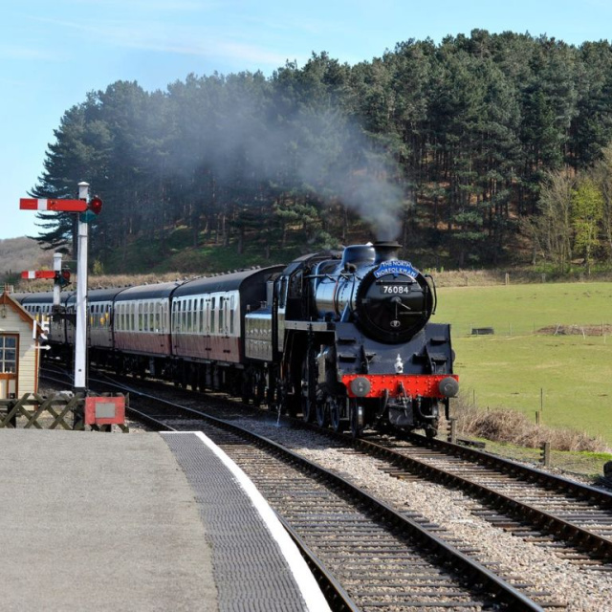
The Big Steam Change!
Discovering the Industrial Revolution and Amazing Inventions

Slide 2
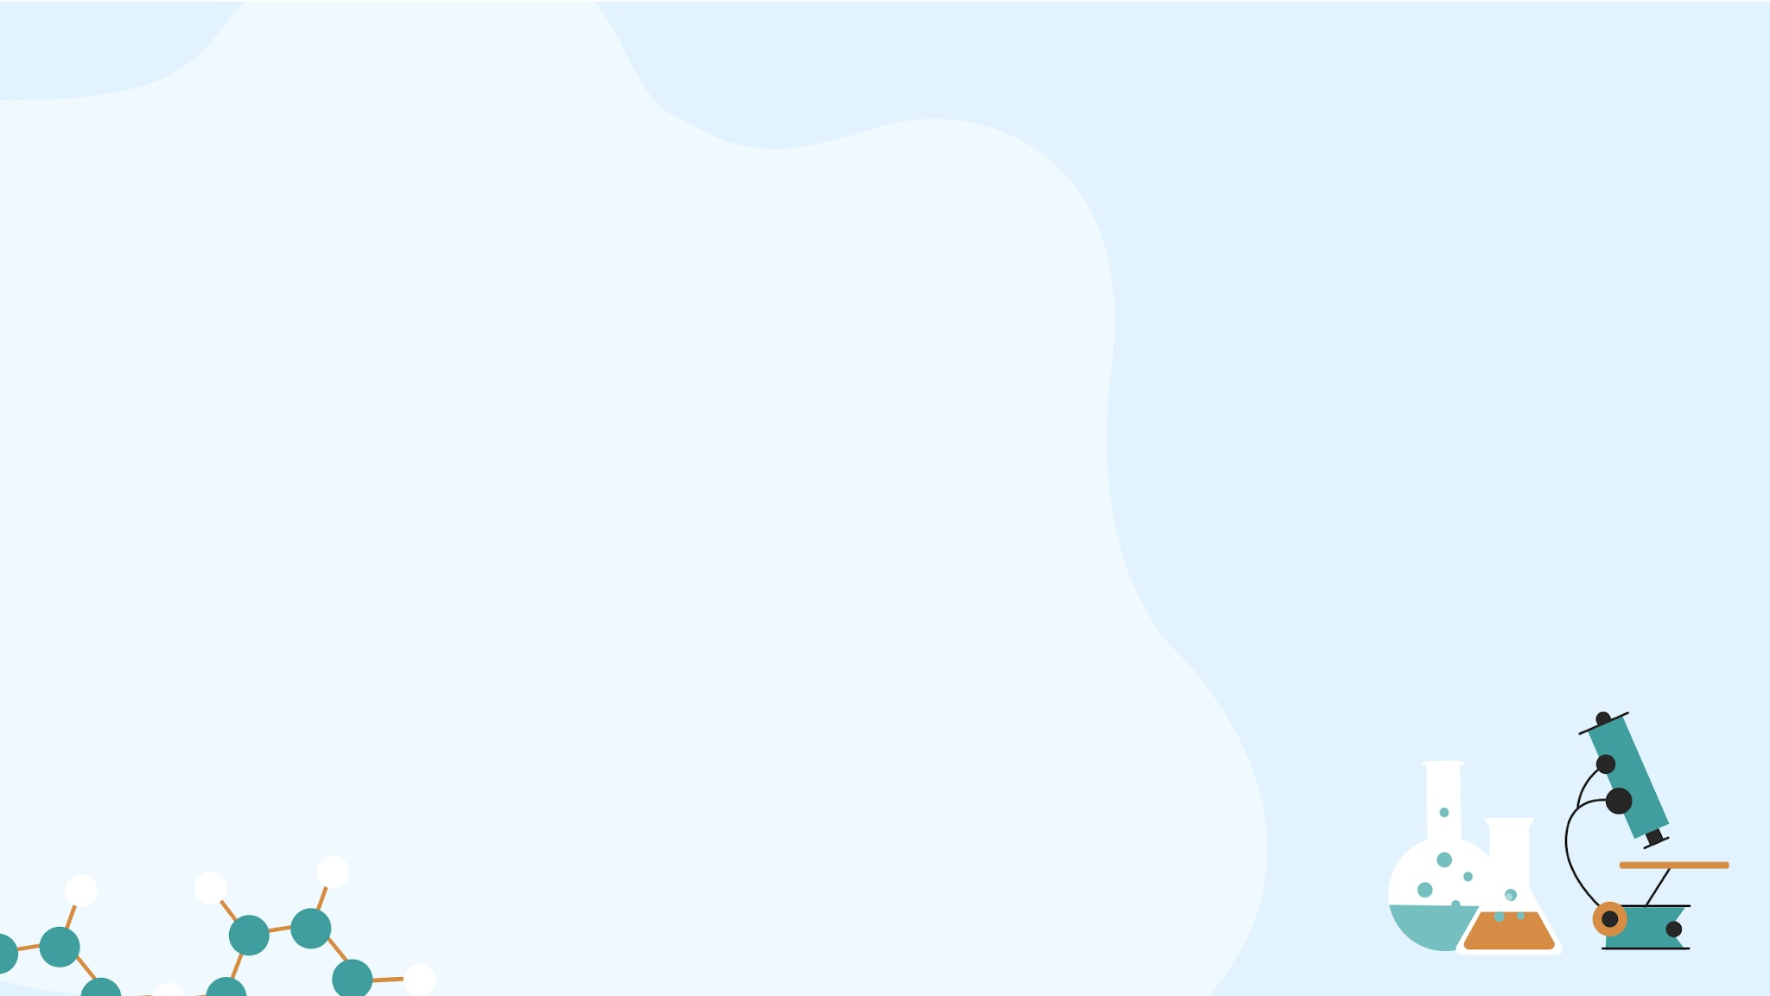
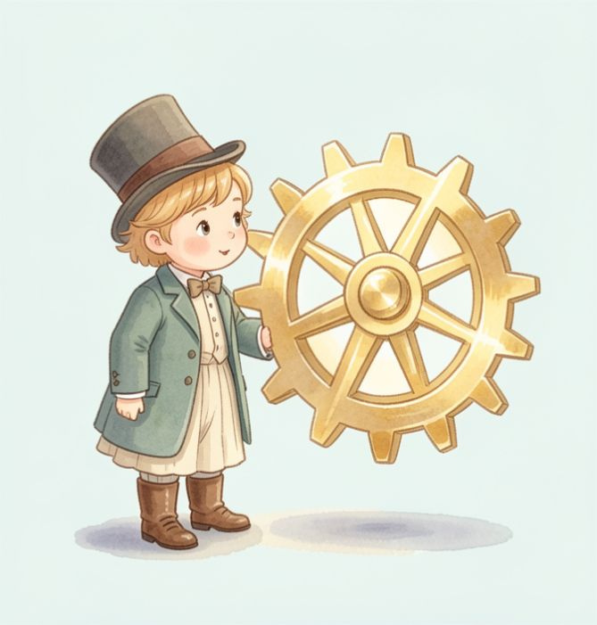
Our Learning Journey
What we are doing today:
Learn how life changed from farms to factories.
Discover how steam power worked.
Design your very own invention!

Slide 3

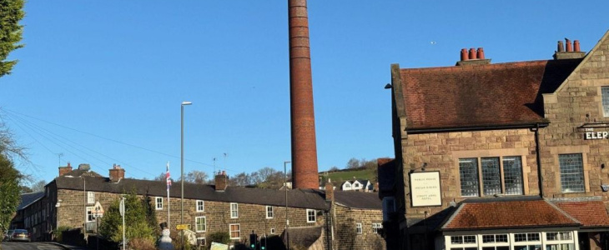
New Words to Know
Invention
A brand new idea or a machine that someone has created for the first time.
Factory
A big building where lots of people work together to make things.

Slide 4
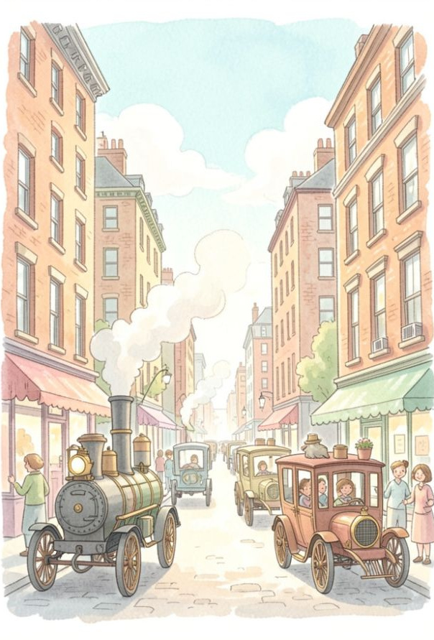
The World is Changing!
Imagine if everything you owned was made by hand at home. Hard work, right?
About 200 years ago, people started using Steam Power to run huge machines. Suddenly, we could make clothes, toys, and tools much faster!
🤯
Fun fact
Before trains, the fastest way to travel was by horse!

Slide 5

See the Steam Engines!
Watch how these amazing machines changed the way people lived and worked.
▶

Slide 6
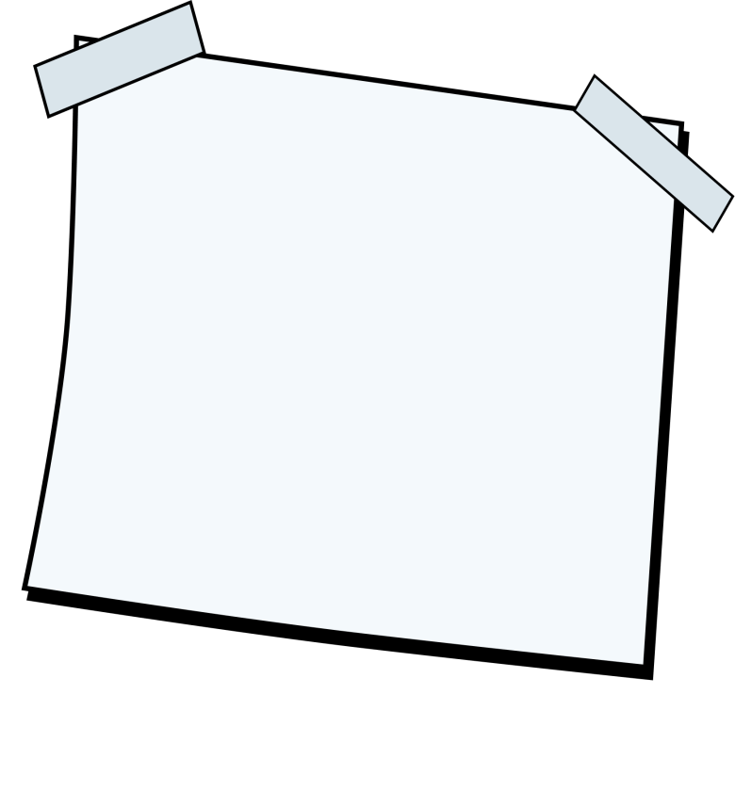
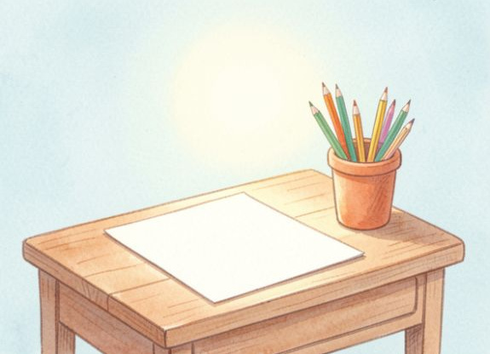
Your Great Invention!
The Victorians invented things like the telephone and the lightbulb. Now it is your turn! Draw a picture of a brand new invention. What does it do? How does it help people? Give it a name!
What you'll need: 🎨​ 🖌️​
Paper, Coloured pencils, Your imagination

